Slide 1
ENG4118/5326 - Robotics 4/M Sensors, Actuators and Image capture, processing and analysis
Lecture 9

Slide 2


Actuators
Mechanical System
Kinematic Chains
CAMS
Gears

Slide 3
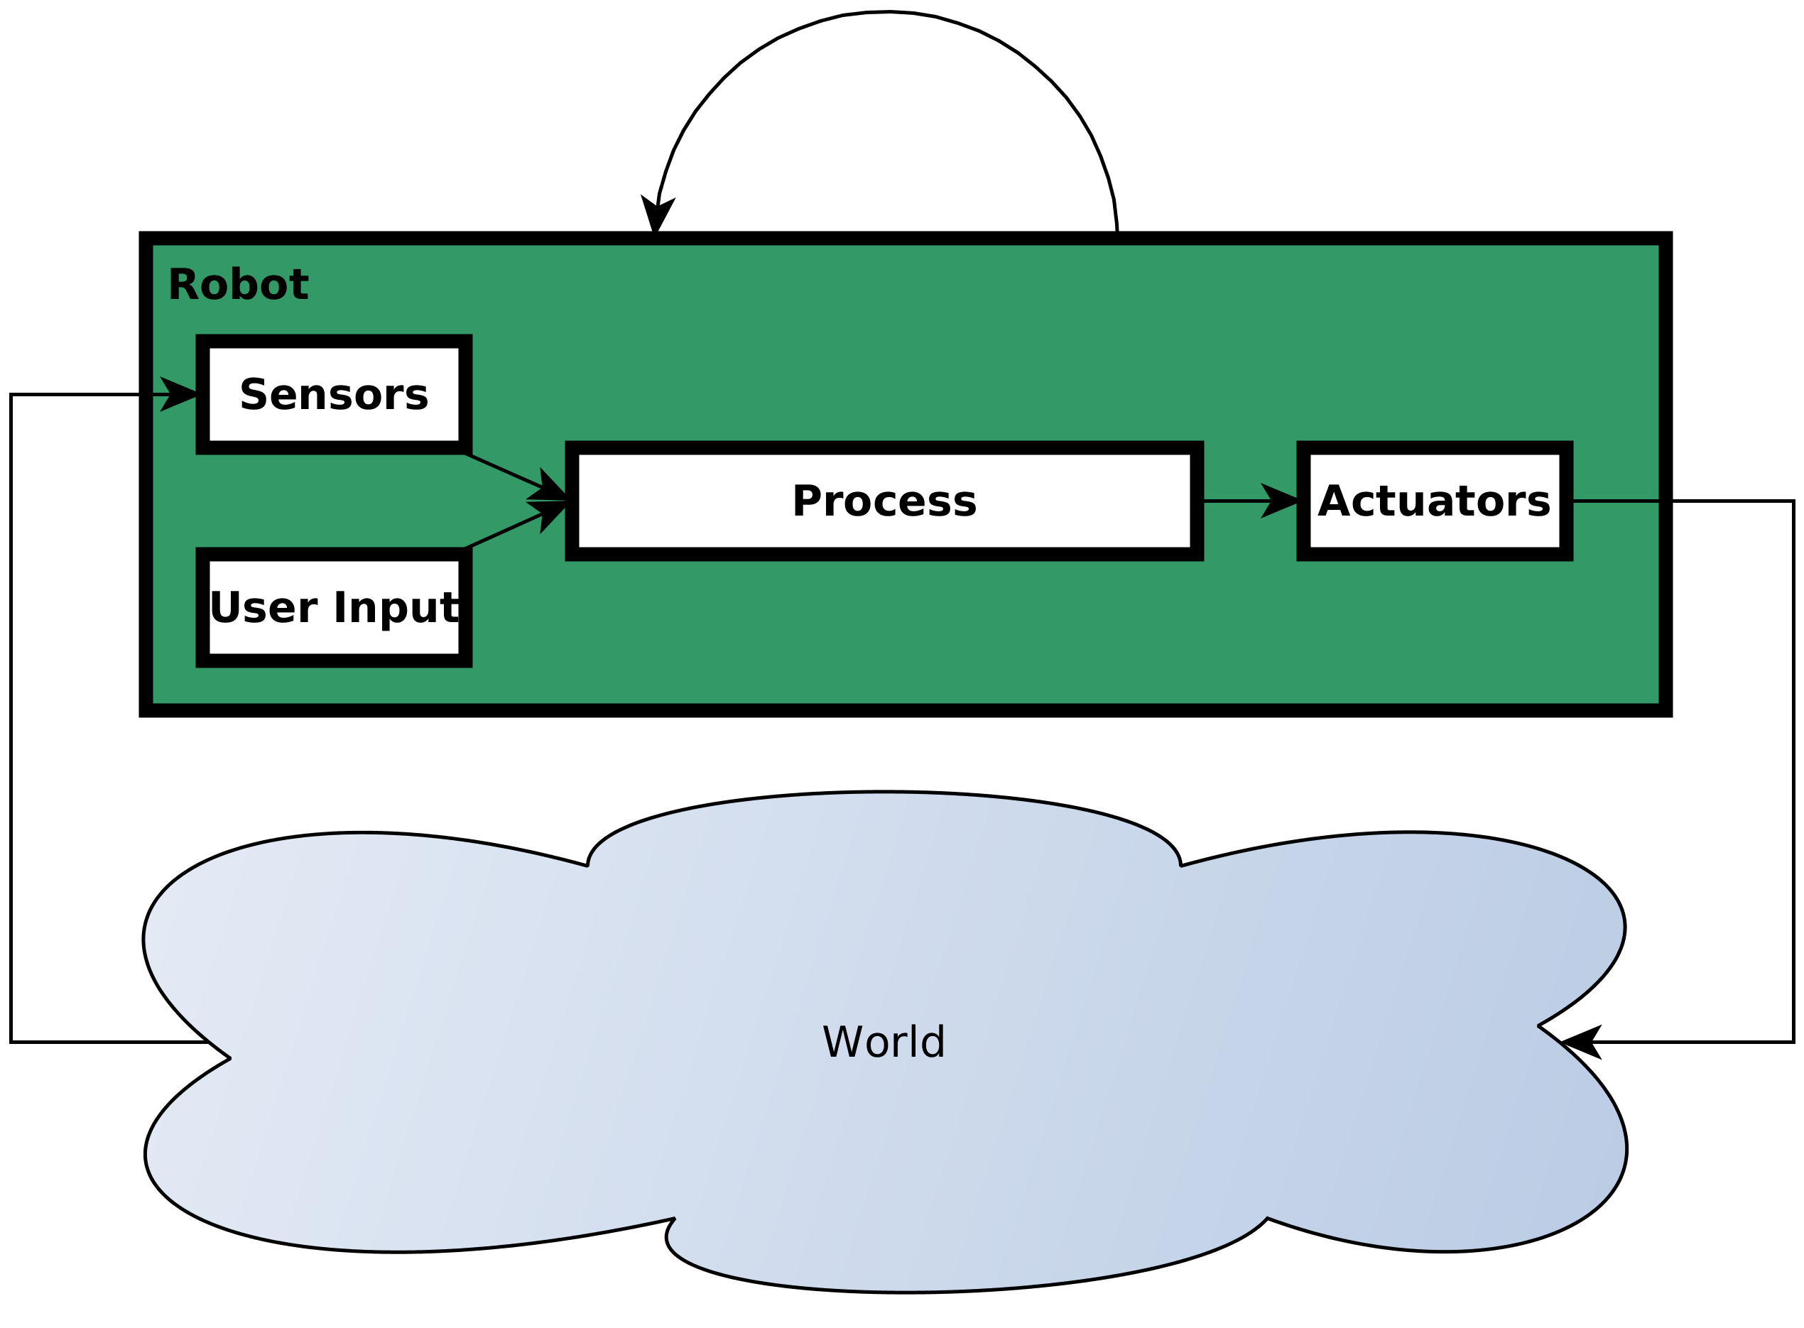
System Overview
Notes:
24/02/2025
3

Slide 4
Actuator
An actuator is the component of a system that is responsible for moving or controlling a mechanism or system
Requires a control signal (electric, hydraulic, pneumatic, thermal, magnetic, mechanical, human...) and a source of energy (electric current, hydraulic fluid pressure, pneumatic pressure...)
When the control signal is received, the actuator responds by converting the energy into mechanical motion
Notes:
24/02/2025
4

Slide 5
Mechanical System
Mechanisms transform one form of motion to some other required form of motion
Mechanical elements can include the use of linkages, cams, gears, rack and pinions, chains, belt drives, etc.
Many of the actions previously obtained using mechanisms are now obtained by the use of micro-processor systems
Mechanisms still have a role to play in mechatronic/robotic systems and provide such functions as:
Force amplification through the use of levers
Change of speed through gearing systems
Transferring rotation from one axis to another using timing belts
Particular types of motion such as quick return mechanisms.
Notes:
24/02/2025
5

Slide 6
Kinematic Chains
When we consider the movement of a mechanism without reference to the forces involved we treat the mechanism as being composed of a series of individual links.
Each part of a mechanism which has motion relative to another part is termed a link.
Links don’t have to be rigid bodies but must be a resistant body capable of transmitting the required force with negligible deformation.
The points of attachment of the link to other links are termed nodes.
A joint is a connection of two or more links at the nodes which allows some motion between the links.
Notes:
24/02/2025
6

Slide 7
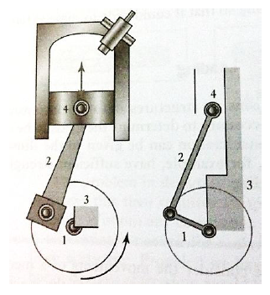
Kinematic Chains
A sequence of joints and links is known as a kinematic chain.
Consider a motor car engine where the reciprocating motion of the piston is transformed into rotational motion of the crankshaft on bearings mounted in a fixed frame.
We represent this as being composed of four connected links:
Link 1. Crankshaft
Link 2. Connecting Rod
Link 3. Fixed Frame
Link 4. Piston
Notes:
24/02/2025
7

Slide 8
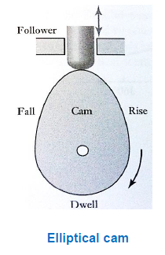
CAMs
A cam is a body which rotates and in doing so imparts a reciprocating motion to a second body called the follower.
As the cam rotates the follower is made to rise, fall or dwell, the lengths of time at each of these positions dependent on the shape of the cam.
Rise section: drives the follower upwards.
Fall section: lowers the follower.
Dwell section: allows the follower to remain stationary and is the circular portion of the cam body
Notes:
24/02/2025
8

Slide 9
CAMs
Notes:
24/02/2025
9

Slide 10
CAMs
https://www.youtube.com/watch?v=WsXC2FiZyzs
24/02/2025
10
Notes:
24/02/2025
10

Slide 11
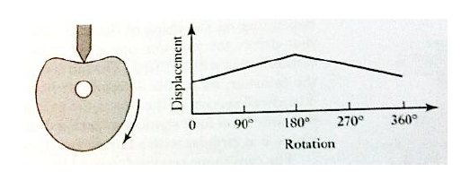
CAMs
Cam shape required to produce a particular type of motion will depend on the shape of the cam and type of follower used.
Uniform speed followers can be obtained by using a heart-shaped cam which give a displacement which decrease or increases at a constant rate.
Notes:
24/02/2025
11

Slide 12
CAMs
https://www.youtube.com/watch?v=7cEH54j2baY
Notes:
24/02/2025
12

Slide 13
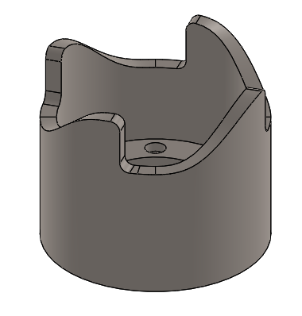
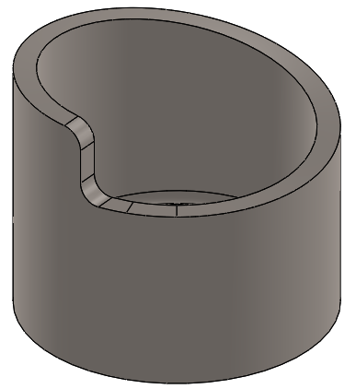
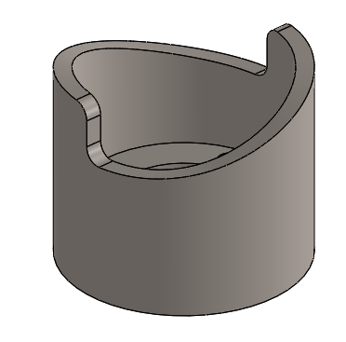
CAMs
Notes:
24/02/2025
13

Slide 14
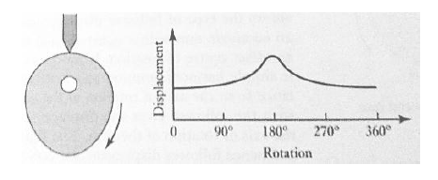
CAMs
Pear shaped cams give a follower motion which is stationary for around half of the revolution of the cam and rises and falls symmetrically in each of the remaining quarter revolutions.
This is used for engine valve control where the dwell holds the valve open while the petrol/air mixture passes into the cylinder.
The greater the dwell (greater length of cam) the more petrol/air mixture can enter the cylinder.
Notes:
24/02/2025
14

Slide 15
Gears
Gears are widely used mechanisms which transfer and transform rotational motion.
They are used when a change in speed and torque of a rotating device is needed and for the transmission of rotary motion between parallel shafts and shafts which have axes inclined to one another.
Bevel Gears describe when the line of shafts of two gears intersect.
When two gears are meshed the larger gear wheel is called the spur or crown wheel and the smaller wheel the pinion.
Spur Gears have gear teeth cut along lines parallel to the gear shaft.
Notes:
24/02/2025
15

Slide 16

Gears
Helical Gears have teeth cut on a helix. They have the advantage of gradual engagement of teeth giving a smoother drive and prolonged life.
However, tooth inclination relative to the axis of the shaft produces an axial force component on the shaft bearing. This can be overcome using double helical gears.
Worm Drives: An arrangement in which a worm (in the form of a screw) meshes with a worm gear (which is similar to a spur gear). This configuration is used to reduce rotational speed and transmit a higher torque.
Gear Ratio: Is the ratio of the angular speed, ω, of two meshed gears and is dependent upon the number of teeth on each wheel which is itself dependent upon wheel diameter, d. For two meshed gears denoted A and B we obtain gear ratio, G:
24/02/2025
16
Notes:
24/02/2025
16

Slide 17
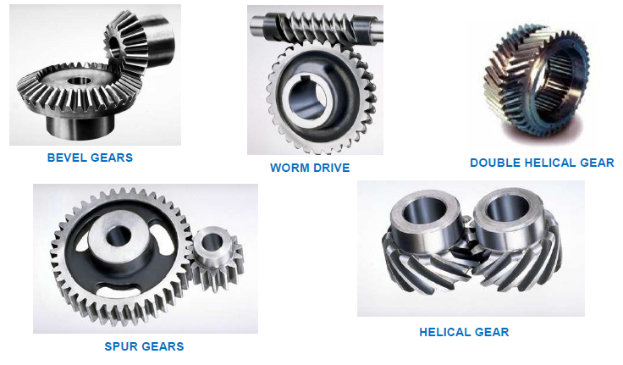
Gears
Notes:
24/02/2025
17

Slide 18
Gear Trains
https://www.youtube.com/watch?v=tjNsUzxRjfw
Notes:
24/02/2025
18

Slide 19
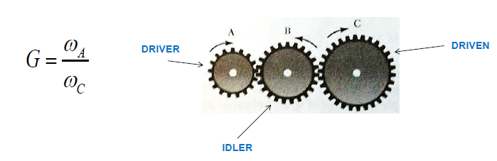
Gear Trains
Gear train a term used to describe a series of intermeshed gear wheels.
Simple gear train is where each shaft in the system carries only one gear wheel.
For simple gears trains the gear ratio is the ratio of the angular velocities at the output and input shafts:
24/02/2025
19
Notes:
24/02/2025
19

Slide 20
Gear Trains
Gear ratio is the ratio of the angular speed, ω, of two meshed gears and is dependent upon the number of teeth on each wheel N which is itself dependent upon wheel diameter, d. For two meshed gears A and B we obtain gear ratio, G:
Notes:
24/02/2025
20

Slide 21

Gear Trains
For simple gears trains, the gear ratio is the ratio of the angular velocities at the output and input shafts which corresponds to the product of the gear ratio for successive pairs of gears:
Notes:
24/02/2025
21

Slide 22
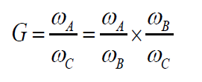
Gear Trains
The effect of wheel B is simply to change the direction of rotation of wheel C and is termed the idler wheel.
It can be seen that the overall gear ratio is the product of the gear ratio for successive pairs of gears:
Compound gear trains describe gear trains when two wheels are mounted on a common shaft.
Notes:
24/02/2025
22

Slide 23
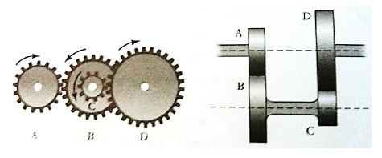
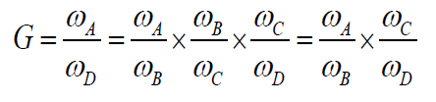

Gear Trains
When two gears are mounted on the same shaft they have the same angular velocity. Here ω_{B} = ω_{C} and the overall gear ratio is:
Notes:
24/02/2025
23

Slide 24

Gear Trains
For the arrangement shown, for the input and output shafts to align we must also have for the radii of the gears:
A simple gear train of spur, helical or bevel gears is usually limited to a overall gear ratio of around 10 and results from needing to keep the gear train down to a manageable size.
Higher gear ratios can be obtained with compound gears because the gear ratio is the product of the individual gear ratios of parallel gear sets.
Notes:
24/02/2025
24

Slide 25
References
Niku, S.B. , Introduction to Robotics, 2nd Edition, Wiley, New Jersey, 2011.
Bolton, W. , Mechatronics, 2nd Edition, Longman, New York, 2000
Notes:
24/02/2025
25

